Slide 1
Microsoft Defender for Cloud + Azure Sentinel - Better Together!
Day 2

Slide 2
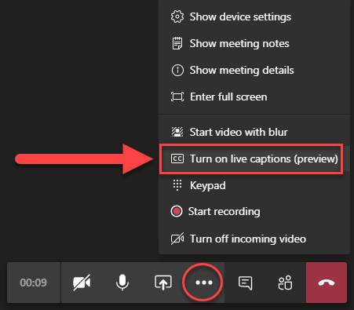
Get Ready!
Set up a place to take notes
Make sure you have something hydrating
Turn on live captions
Find your favorite gif
Need help? Drop a message in the chat window so our team can assist!
Ellipsis

Slide 3
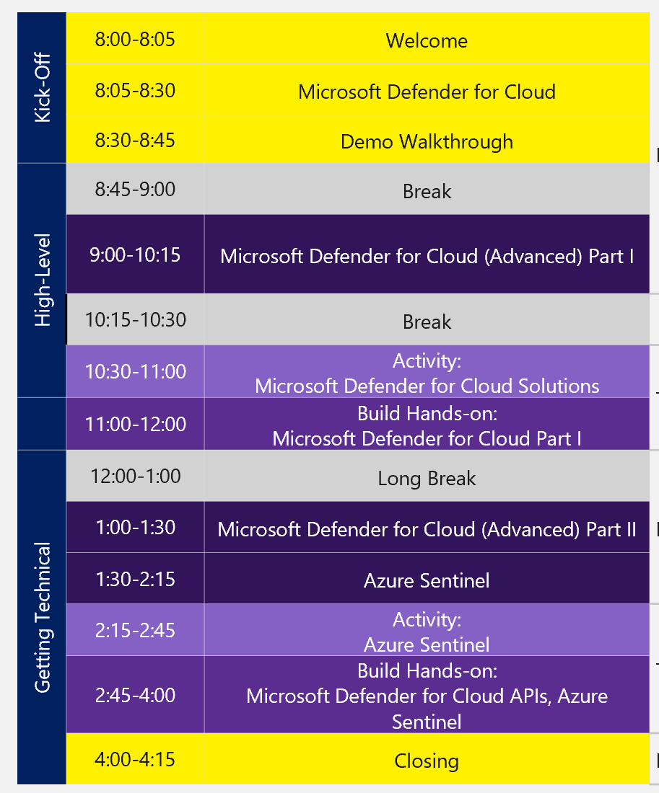
Better Together: Overview
Day 1
Day 2
Welcome
Welcome
Microsoft Defender for Cloud
Microsoft Defender for Cloud + Azure Sentinel: Better Together
Demo Walkthrough
Log Analytics + Kusto Query Language
Break
Activity: Estimating Costs
Microsoft Defender for Cloud (Advanced) Part 1
Hands-on: Log Analytics
Break
Break
Activity: Microsoft Defender for Cloud Solutions
Azure Automation
Hands-on: Microsoft Defender for Cloud Part 1
Activity: Azure Automation
Break
Break
Microsoft Defender for Cloud (Advanced) Part 2
Security Operations Center / Microsoft SOC
Azure Sentinel
Break
Activity: Azure Sentinel
Microsoft Defender for Cloud + Azure Sentinel: Better Together
Hands-on: Microsoft Defender for Cloud APIs, Azure Sentinel
Hands-on: Azure Automation + Azure Sentinel
Close
Close

Slide 4
Today’s Agenda
5
min
Welcome
10
min
Microsoft Defender for Cloud +
Azure Sentinel: Better Together
45
min
Log Analytics + Kusto Query Language
Activity: Estimating Costs
30
min
30
min
Hands-on: Log Analytics
15
min
Break
30
min
Azure Automation
30
min
Activity: Azure Automation
Table Groups
60
min
Break
60
min
Security Operations Center (SOC)
15
min
Break
30
min
Microsoft Defender for Cloud +
Azure Sentinel: Better Together
75
min
Hands-on: Azure Automation +
Azure Sentinel
Table Groups
10
min
Close

Slide 5

Microsoft Defender for Cloud + Azure Sentinel - Better Together!

Slide 6
Better Together
How does all this fit into one cohesive story for customers?
Microsoft Defender for Cloud and Azure Sentinel rely on Log Analytics, KQL and Azure Automation to implement a well-oiled, agile, Security Operations Center (SOC).
Security Analysts will utilize ALL of these tools to respond to threats and protection the organization.

Slide 7
Comprehensive Protection
Azure control plane will be monitored by Microsoft Defender for Cloud.
Microsoft Defender for Endpoint will monitor the compute infrastructure.
Azure Sentinel will monitor all log data with extensive pre-built hunting queries supplemented with impressive SOAR capabilities.
Automatic remediation through Azure Sentinel + Azure Automation and Microsoft Defender 365 will ensure threats are stopped immediately.

Slide 8
Bringing it all together
Today will focus on Azure Log Analytics and some considerations past simply “Log Everything” such as Purging, Exporting and Compliance.
Log Analytics utilizes the Kusto Query Language (KQL) and an understanding of this query language is a MUST for Microsoft Security professionals.
There are many edge cases of KQL features that must be explored to understand how to compete with other SIEM/SOAR systems
Most implemented SIEMs will have some kind of on-premises remediation actions, you will need to know how to handle these situations with Azure Automation.
Lastly, having an understanding of how to run an efficient Security Operations Center (SOC) will be vital to helping customers achieve the same. Using Microsoft’s own SOC best practices, you will learn how to respond to threats through a live attack scenario in a lab environment.

Slide 9
Log Analytics

Slide 10
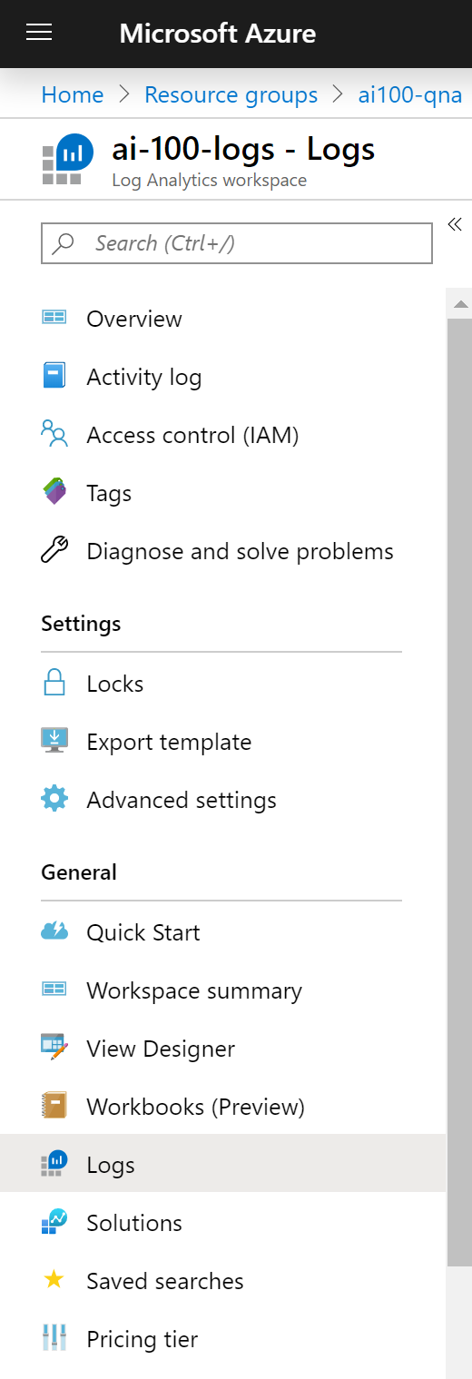
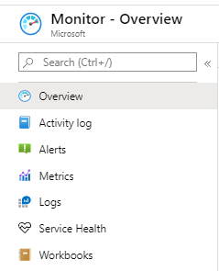
Log Analytics Workspace
The Azure resource used to collect logging data
Linked Azure resources will make corresponding Logs available via blade menu
Logs are queried based on Kusto Query Language (KQL)
Provides limited Visual Designer for building queries
Notes:
Log Analytics is a tool in the Azure portal to edit and run log queries from data collected by Azure Monitor Logs and interactively analyze their results. You can use Log Analytics queries to retrieve records matching particular criteria, identify trends, analyze patterns, and provide a variety of insights into your data.
It can be considered as the basic management unit of Azure Monitor Logs. It is used to collect data from various sources such as Azure Virtual Machines, Windows or Linux Virtual Machines, Azure Resources in a subscription, etc. You may have different resources under different subscriptions and various Azure Monitors to monitor them. An Azure Log Analytics Workspace is a logical storage unit in Azure where all log data generated by Azure Monitors are stored. Azure Log Analytics Workspace makes it easier for us to manage the log data that is collected from various data sources like Azure Virtual Machines.

Slide 11
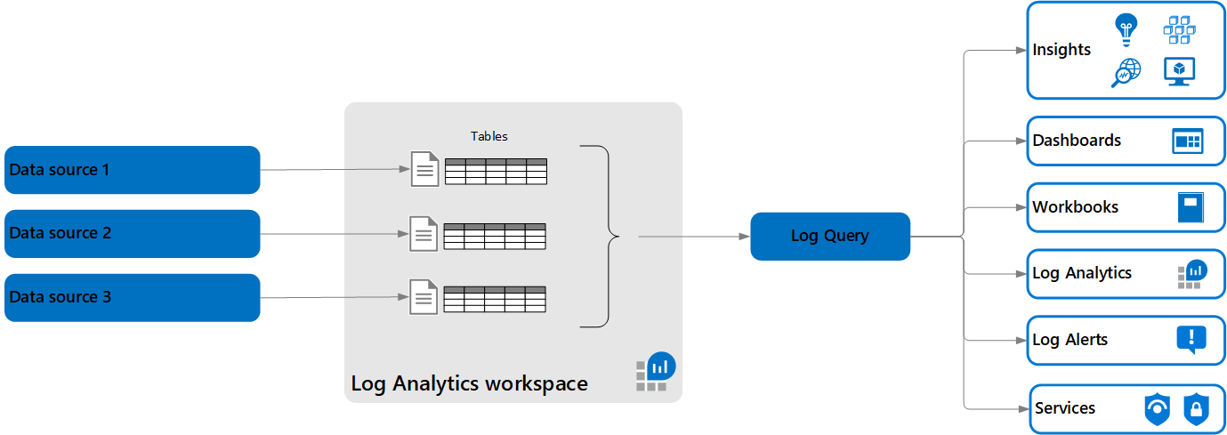
Log Analytics – Architecture
Log queries retrieve their data from a Log Analytics workspace.
Each workspace contains multiple tables are that are organized into separate columns with multiple rows of data. Each table is defined by a unique set of columns that are shared by the rows of data provided by the data source.
Notes:
https://docs.microsoft.com/en-us/azure/azure-monitor/logs/data-platform-logs

Slide 12

Azure Data Explorer
Azure Data Explorer is a fast, fully managed data analytics service for real-time analysis on large volumes of data streaming from applications, websites, IoT devices, and more. You can use Azure Data Explorer to collect, store, and analyze diverse data to improve products, enhance customer experiences, monitor devices, and boost operations.
A Log Analytics workspace is roughly the equivalent of a database in Azure Data Explorer, tables are structured the same, and both use the same Kusto Query Language (KQL).
The experience of using Log Analytics to work with Azure Monitor queries in the Azure portal is similar to the experience using the Azure Data Explorer Web UI.

Slide 13
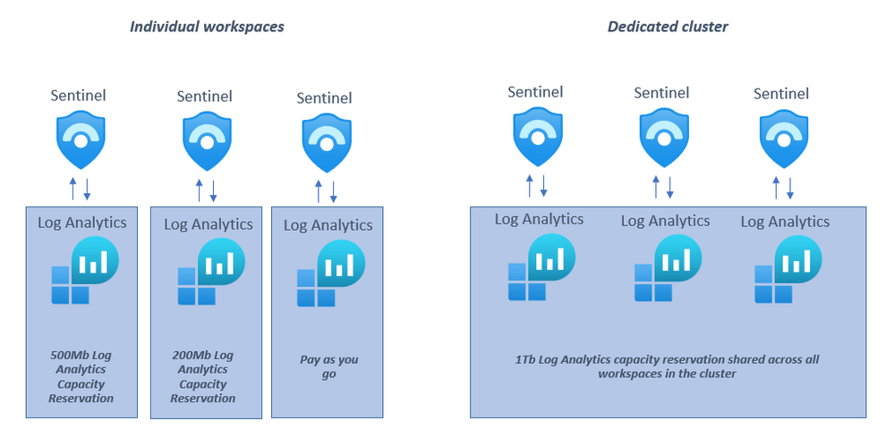
Log Analytics – Dedicated Cluster
Log Analytics dedicated clusters are available for
production deployment (registration is required
to ensure capacity), supporting high scale and
advanced scenarios such as data encryption at rest
with Customer-Managed Keys (CMK) and Lockbox.
These dedicated clusters are collections of
workspaces rolled into a single managed cluster,
which can be used to better handle large
scale deployments.
Clusters will only contain workspaces that you select, enabling you to also benefit from cluster-level capacity reservation (starting at 1000GB/day) with discounted pricing.

Slide 14
Log Analytics – Dedicated Cluster Features
Data Encryption at Rest: Azure Monitor ensures that all data and saved queries are encrypted at rest using Microsoft-managed keys (MMK). Azure Monitor also provides an option for encryption using your own key that is stored in your Azure Key Vault and accessed by storage using system-assigned managed identity authentication. This key (CMK) can be either software or hardware-HSM protected and is available only for dedicated clusters.
LockBox: Lockbox is provided on the Log Analytics dedicated cluster where data is kept in storage accounts under your Lockbox protected subscription. Lockbox gives you control, allowing you to approve or reject Microsoft engineer request to access your data during a support request.
Rate limit: You can have higher ingestion rate limits only on dedicated cluster.
Consistency: You have your own dedicated resources and so there is consistency in terms of performance and latency.
Speed: Cross-workspace queries run faster if all workspaces are on the same cluster.
Notes:
https://docs.microsoft.com/en-us/azure/azure-monitor/logs/logs-dedicated-clusters
https://azure.microsoft.com/en-us/updates/dedicated-clusters-for-azure-monitor-log-analytics-with-cmk-lockbox/
https://techcommunity.microsoft.com/t5/azure-sentinel/what-s-new-dedicated-clusters-for-azure-sentinel/ba-p/2072539

Slide 15
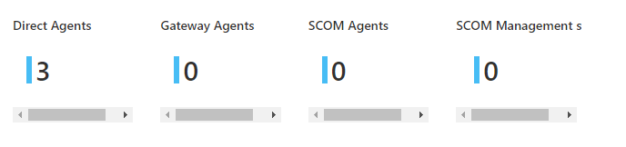
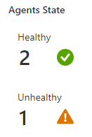
Agents, agents and more agents
Microsoft Monitoring Agent
Direct and Gateway
System Center Operations Manager Agent
Azure Arc, VM Assessment, Dependency

Slide 16
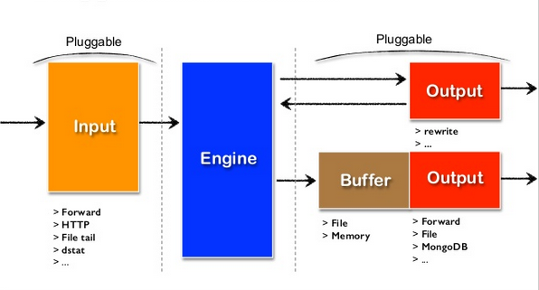
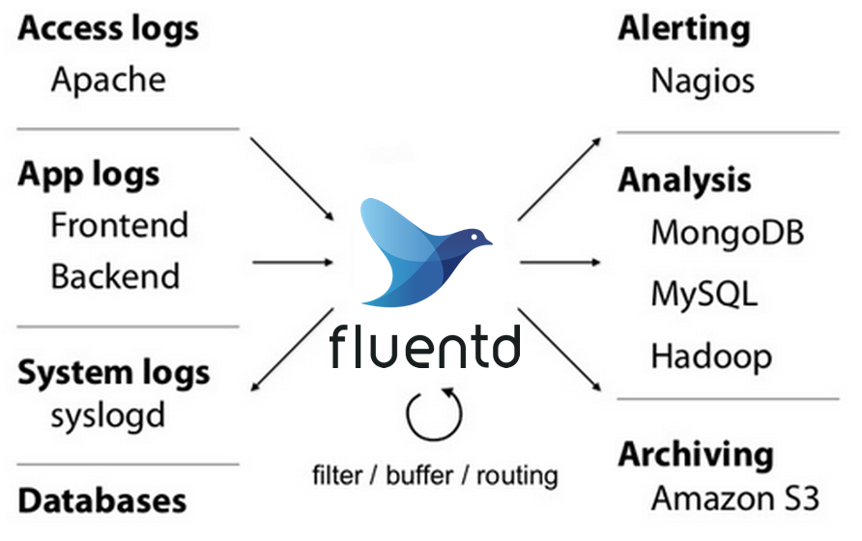
Fluentd
The most direct way to create a custom connector is to use the Log Analytics agent. It is based on Fluentd and can use any Fluentd input plugin bundled with the agent to collect events and then forward them to an Azure Sentinel workspace.
Fluentd is an open source data collector, which lets you unify the data collection and consumption for a better use and understanding of data.

Slide 17
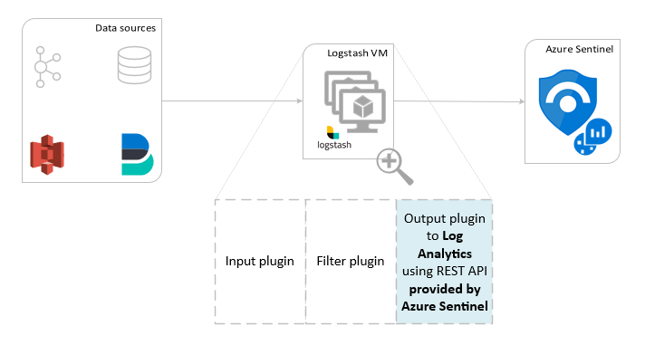
Logstash
The Logstash engine is comprised of three components:
Input plugins: Customized collection of data from various sources.
Filter plugins: Manipulation and normalization of data according to specified criteria.
Output plugins: Customized sending of collected and processed data to various destinations.

Slide 18
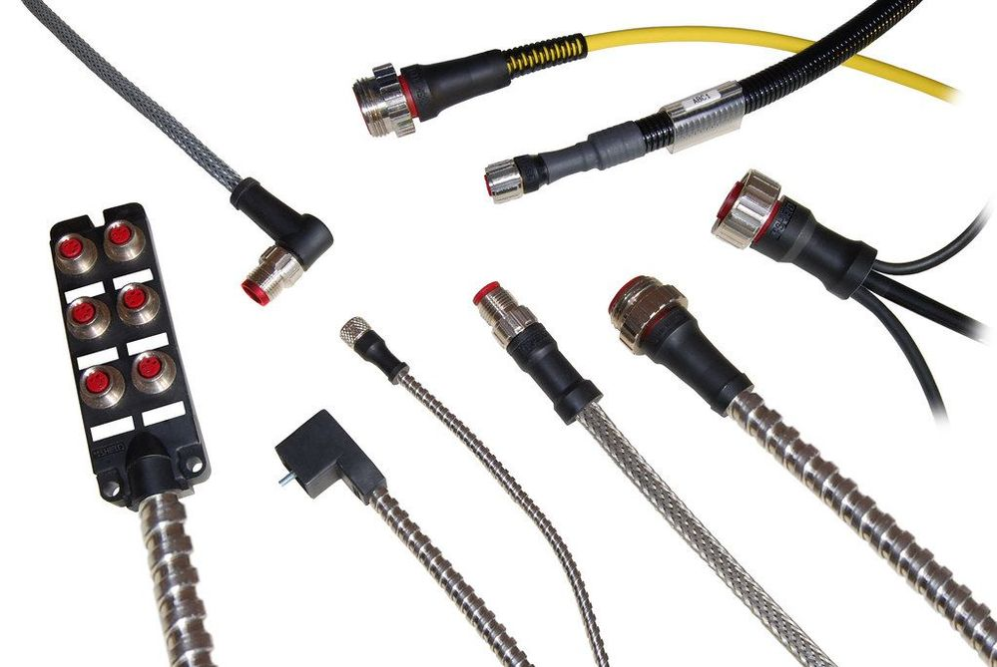
Data Collector API
All the methods discussed use the Log Analytics Data Collector API to stream events to Log Analytics / Azure Sentinel.
You can use the API directly to ingest any data to Sentinel. While it would require programming, it naturally offers the most flexibility.
To use the API, you can directly call the RESTful endpoint using C#, Python 2, Java, PowerShell, or any other language, or utilize the available client libraries.
Notes:
https://techcommunity.microsoft.com/t5/azure-sentinel/azure-sentinel-creating-custom-connectors/ba-p/864060

Slide 19
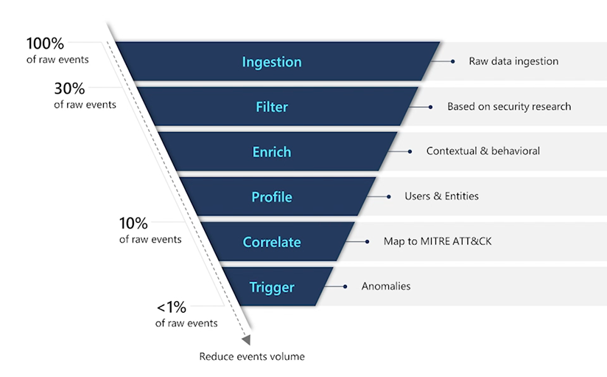
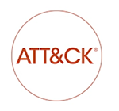
Logging - Focus on what’s important

Slide 20
Parsing Data (Ingest or Query time?)
Query Time: Parsing at query time means you don't need to know your data's exact structure ahead of time, when you create your custom connector, or even the information you'll need to extract. Instead, parse your data at any time, even during an investigation.
Ingest Time: You can use your custom connector's built-in parsing technique to extract the relevant information and populate the relevant fields in Azure Sentinel.
For example:
If you've used Logstash, use the Grok filter plugin to parse your data.
If you've used an Azure function, parse your data with code.

Slide 21



Pricing / Estimating / ADX
There are two ways to pay for ingesting data into Log Analytics:
Capacity Reservations and Pay-As-You-Go.
More than just ingestion that must be considered.
Retention
Alert Rules
Notifications

Slide 22
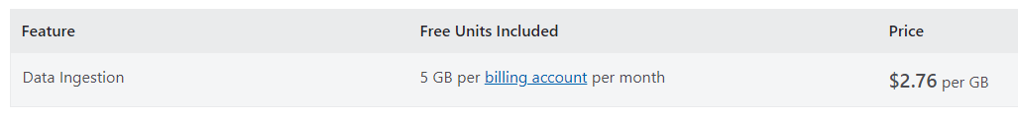
Pay-As-You-Go
With Pay-As-You-Go pricing, you are billed per gigabyte (GB) of data ingested into the Log Analytics workspace.

Slide 23
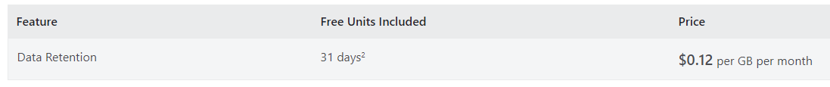
Retention
Every GB of data ingested into your Azure Monitor Log Analytics workspace can be retained at no charge for up to first 31 days.
For Azure Sentinel enabled workspaces the data is retained for free for 90 days.

Slide 24
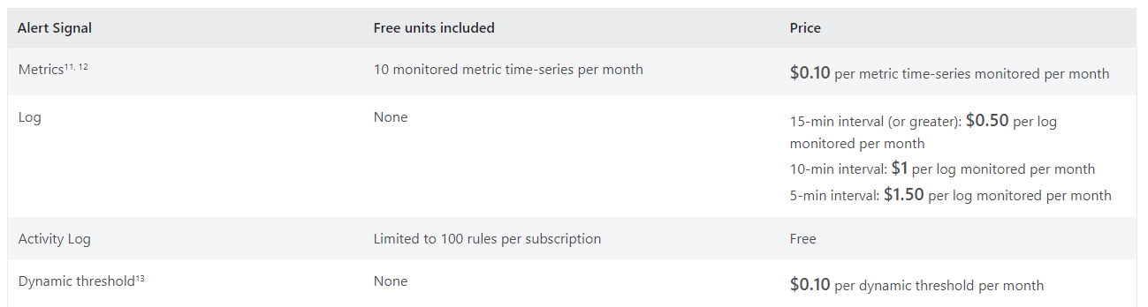
Alert Rules
An alert rule is charged based on the type and number of signals it monitors. A signal can be a resource metric, a log or an activity log. The cost of an alert rule that monitors multiple signals is the sum of the cost of monitoring each signal and any enabled features.

Slide 25
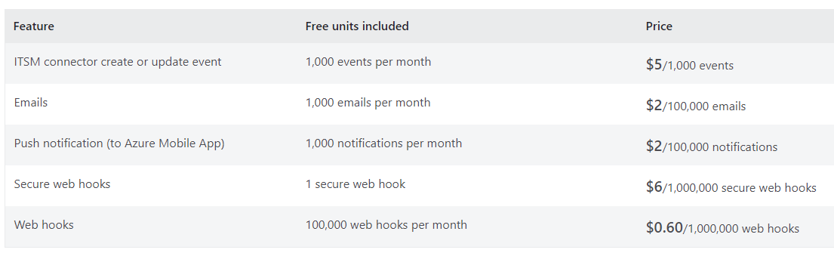
Notifications
Notifications are sent based on when an Alert rule triggers. You are billed based on the type and number of notifications you choose to send.

Slide 26
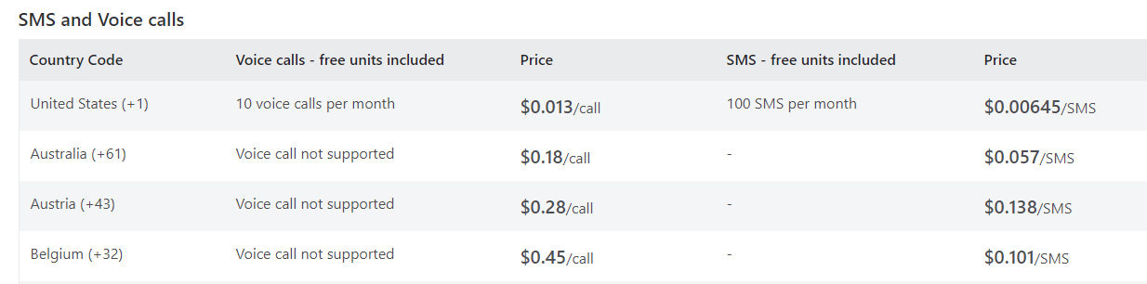
Notifications (SMS and Voice)
Notifications are sent based on when an Alert rule triggers. SMS and Voice charges vary by country.

Slide 27
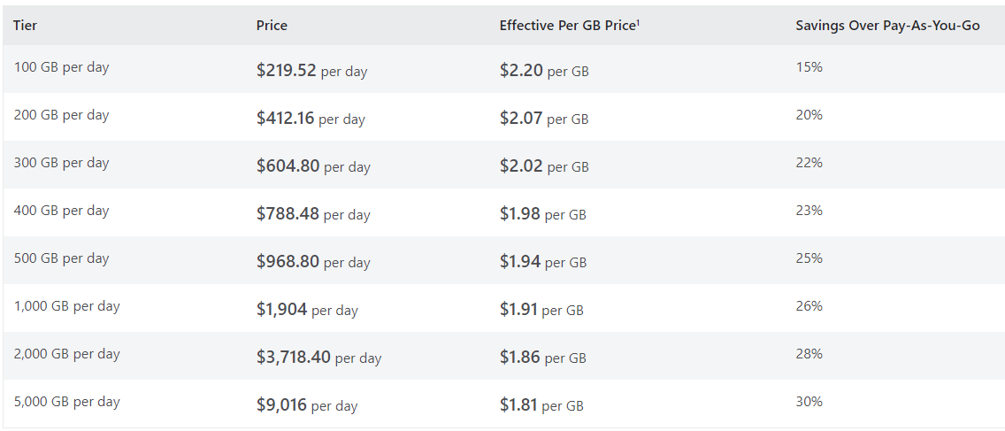
Commitment Tiers
With Commitment tiers you are billed a fixed predictable fee based on your selected commitment tier. Commitment tiers provide you a discount on data ingestion based on your selected commitment tier compared to Pay-As-You-Go pricing.

Slide 28
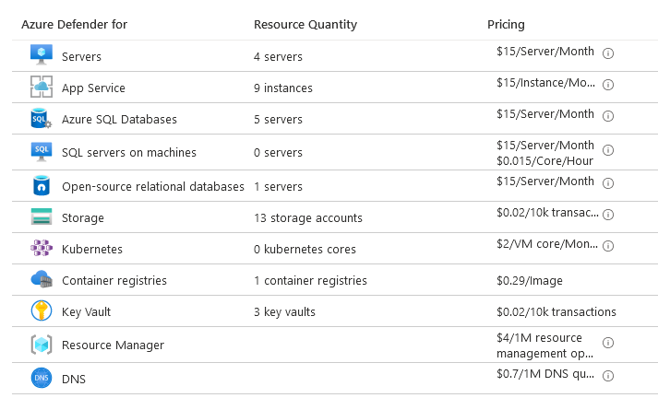
Microsoft Defender for Cloud Costs
In addition to the Log Analytics and Sentinel costs, you must also consider the Microsoft Defender for Cloud costs of any security solution.

Slide 29
Solutions
Log Analytics solutions are a collection of logic, visualization and data acquisition rules that provide metrics pivoted around a particular problem area.
Microsoft’s monitoring solution was called System Center Operations Manager (SCOM).
It is an agent-based monitoring solution.
SCOM relies on “management packs”.
Management packs supply the logic to make it possible to monitor services, applications, infrastructure, and more.
Think of a Log Analytics workspace as a SCOM management group which is freshly installed.

Slide 30
Types of Solutions
Examples of Log Analytics solutions:
Active Directory Assessment
Alert Management (without SCOM alerts)
Antimalware
Change Tracking
Security
SQL Assessment
System Updates
You can search for Solutions in the Global Search bar of Azure.

Slide 31
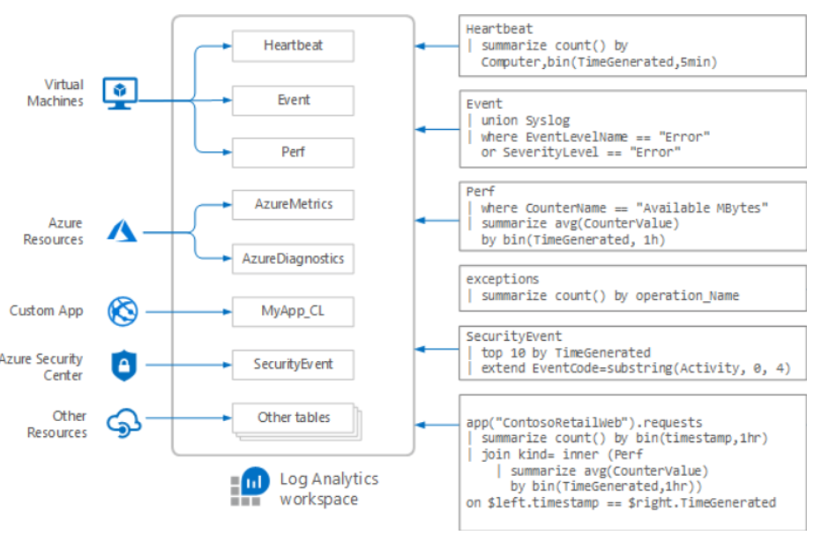
Tables, tables and more tables
Every solution or data connector that is enabled adds more tables to the Log Analytics workspace.

Slide 32
Solution Targeting
When you add a monitoring solution to your subscription, it's automatically deployed by default to all Windows and Linux agents connected to your Log Analytics workspace. You may want to manage your costs and limit the amount of data collected for a solution by limiting it to a particular set of agents.
Specify the computers that you want to include in a scope by creating a computer group.
The computer group can be based on a log query or imported from other sources such as Active Directory or WSUS groups.
Only computers that are directly connected to the workspace will be included in the scope.
Once you have a scope configuration, then you can apply it to one or more solutions.
Note that while a single scope configuration can be used with multiple solutions, each solution can only use one scope configuration.

Slide 33
Solutions + Cost
The majority of the Solutions available are free to deploy. Keep in mind that they all increase the amount of data you’re ingesting into your Log Analytics workspace.
The more data you collect the higher the cost of using Log Analytics.

Slide 34


Question…
What was Log Analytics previous name?
Notes:
Log Analytics was previously called Operational Insights, which is why it is the name used in the cmdlets.

Slide 35
Question…
What is the maximum number of custom logs that can be created?
What is the maximum number of columns in a table?
Notes:
A Log Analytics workspace supports the following limits:
Only 500 custom logs can be created.
A table only supports up to 500 columns.
The maximum number of characters for the column name is 500.

Slide 36
30, 90 days, oh my.

Slide 37
Retention
Default Log Analytics retention is 30 days.
Add Azure Sentinel, it expands to 90 days.
You have 90 days to resolve your alerts and incidents, if you go past this you risk losing information on the incident.
What do you do?

Slide 38
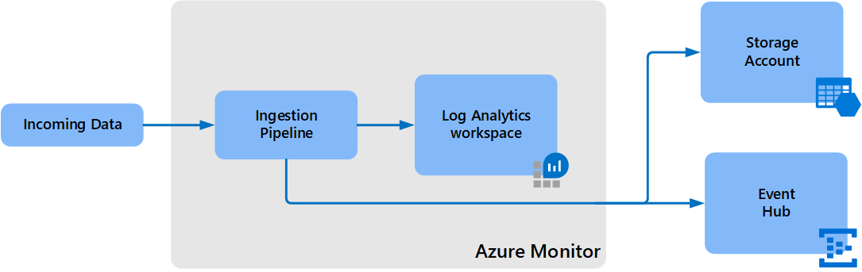
Export
Log Analytics workspace data export in Azure Monitor allows you to continuously export data from selected tables in your Log Analytics workspace to an Azure storage account or Azure Event Hubs as it's collected.
All data from included tables is exported without a filter. For example, when you configure a data export rule for SecurityEvent table, all data sent to the SecurityEvent table is exported starting from the configuration time.

Slide 39
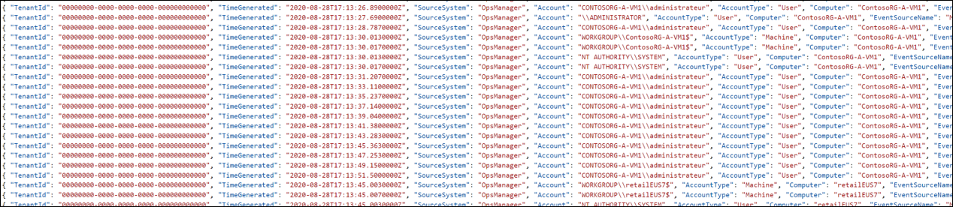
Export – Targets
Storage Account - Data is sent to storage accounts as it reaches Azure Monitor and stored in hourly append blobs. The data export configuration creates a container for each table in the storage account with the name am- followed by the name of the table. For example, the table SecurityEvent would sent to a container named am-SecurityEvent.
Event Hub - Data is sent to your event hub in near-real-time as it reaches Azure Monitor. An event hub is created for each data type that you export with the name am- followed by the name of the table. For example, the table SecurityEvent would sent to an event hub named am-SecurityEvent. If you want the exported data to reach a specific event hub, or if you have a table with a name that exceeds the 47 character limit, you can provide your own event hub name and export all data for defined tables to it.

Slide 40
Azure Data Explorer Revisited
Azure Data Explorer is a fast and highly scalable data exploration service for log and telemetry data.
It helps you handle the many data streams emitted by modern software, so you can collect, store, and analyze data.
Azure Data Explorer is ideal for analyzing large volumes of diverse data from any data source, such as websites, applications, IoT devices , and more.
This data is used for diagnostics, monitoring, reporting, machine learning, and additional analytics capabilities.
Azure Data Explorer makes it simple to ingest this data and enables you to do complex ad hoc queries on the data in seconds.
Azure Data Explorer can consume the Event Hub target from the Log Analytics Data Export process.

Slide 41
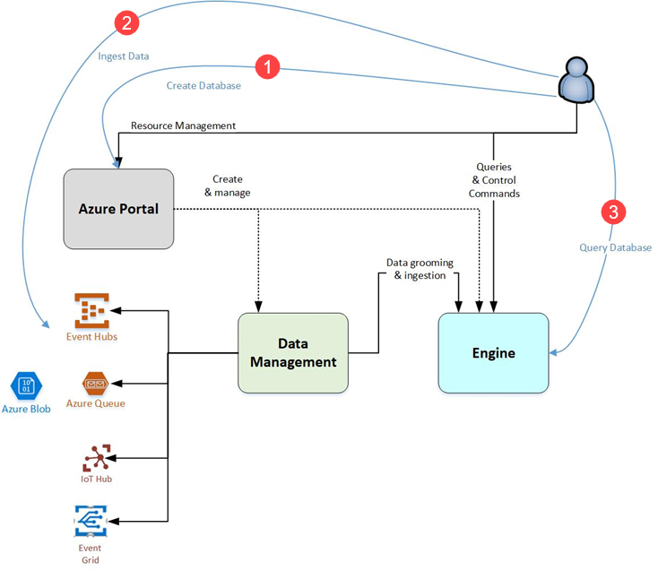
Azure Data Explorer - Architecture
Create database: Create a cluster and then create one or more databases in that cluster.
Ingest data: Load data into database tables so that you can run queries against it.
Query database: Use our web application to run, review, and share queries and results. It's available in the Azure portal and as a stand-alone application. You can also send queries programmatically (using an SDK) or to a REST API endpoint.

Slide 42
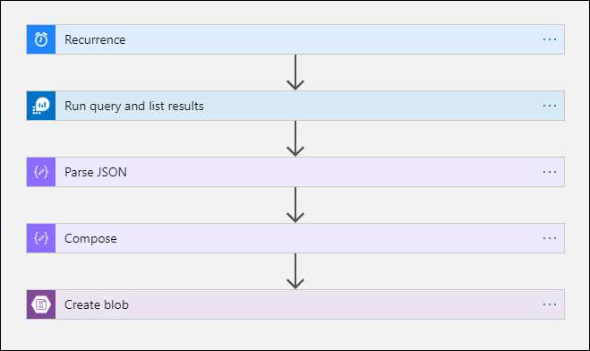
Export – Logic App
This procedure uses the Azure Monitor Logs connector which allows you to run a log query from a logic app and use its output in other actions in the workflow.
The Azure Blob Storage connector is used in this procedure to send the query output to Azure storage.

Slide 43
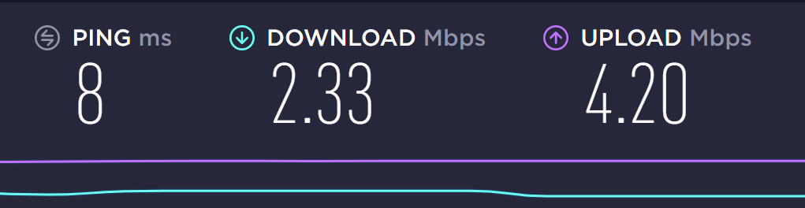
Connector Limits
Log Analytics workspace and log queries in Azure Monitor are multitenancy services that include limits that protect and isolate customers and maintain quality of service.
When querying for a large amount of data, you should consider the following limits, which can affect how you configure the Logic App recurrence and your log query:
Log queries cannot:
return more than 500,000 rows
return more than 64,000,000 bytes
run longer than 10 minutes by default
Log Analytics connector is limited to 100 calls per minute.

Slide 44

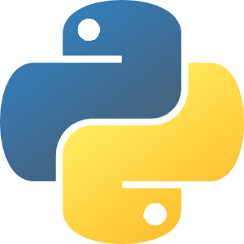

Data Lake + Python + Machine Learning
Once data has been exported to a Storage Account / Data Lake, it can be consumed by Notebooks.
Notebooks can execute advanced Machine Learning algorithms against the data.
Outcomes can then be sent back to Azure Sentinel as incidents.

Slide 45
Purging and Compliance

Slide 46
Purging
Purge is a highly privileged operation that no app or user in Azure (including even the resource owner) will have permissions to execute without explicitly being granted a role in Azure Resource Manager.
This role is Data Purger and should be cautiously delegated due to the potential for data loss.
In order to manage system resources, purge requests are throttled at 50 requests per hour.
You should batch the execution of purge requests by sending a single command whose predicate includes all user identities that require purging.
You should run the query before executing the purge request to verify that the results are expected.
While we expect the vast majority of purge operations to complete much quicker than our SLA, due to their heavy impact on the data platform used by Log Analytics, the formal SLA for the completion of purge operations is set at 30 days.

Slide 47
Purging – Why?
Log Analytics is a data store where personal data is likely to be found. Application Insights stores its data in a Log Analytics partition.
Log data refers to data sent to a Log Analytics workspace, while application data refers to data collected by Application Insights. If you are using a workspace-based Application Insights resource, the information on log data will apply but if you are using the classic Application Insights resource then the application data applies.
Where possible, stop collection of, obfuscate, anonymize, or otherwise adjust the data being collected to exclude it from being considered "private".
Where not possible, attempt to normalize the data to reduce the impact on the data platform and performance. For example, instead of logging an explicit User ID, create a lookup data that will correlate the username and their details to an internal ID that can then be logged elsewhere. That way, should one of your users ask you to delete their personal information, it is possible that only deleting the row in the lookup table corresponding to the user will be sufficient.
Finally, if private data must be collected, build a process around the purge API path and the existing query API path to meet any obligations you may have around exporting and deleting any private data associated with a user.

Slide 48
Purging – What?
IP addresses: Log Analytics collects a variety of IP information across many different tables.
User IDs: User IDs are found in a large variety of solutions and tables.
Device IDs: Like user IDs, device IDs are sometimes considered "private".
Custom data: Log Analytics allows the collection in a variety of methods: custom logs and custom fields, the HTTP Data Collector API , and custom data collected as part of system event logs.
Solution-captured data: Because the solution mechanism is an open-ended one, we recommend reviewing all tables generated by solutions to ensure compliance.

Slide 49
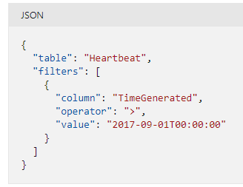
Purging – How?
POST https://management.azure.com/subscriptions/00000000-0000-0000-0000-00000000000/resourceGroups/OIAutoRest5123/providers/Microsoft.OperationalInsights/workspaces/aztest5048/purge?api-version=2020-08-01

Slide 50
Kusto Query Language

Slide 51
Kusto Query Language (KQL)
A Kusto query is a read-only request to process data and return results
The request is stated in plain text, using a data-flow model designed to make the syntax easy to read, author, and automate
The query uses schema entities that are organized in a hierarchy similar to SQL's: databases, tables, and columns
https://docs.microsoft.com/en-us/azure/kusto/query/

Slide 52
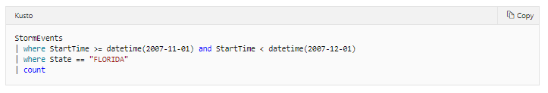
Selecting Data
Start with a reference to a table (StormEvents)
Add a newline starting with a pipe (|) with your where query
Last line will be (|) and the columns you would like returned (count)

Slide 53
KQL – Common Operators
Some useful KQL operators:
where - Filter a table to the subset of rows that satisfy a predicate.
summarize - Produce a table that aggregates the content of the input table.
join - Merge the rows of two tables to form a new table by matching values of the specified column(s) from each table.
count - Return the number of records in the input record set.
top - Return the first N records sorted by the specified columns.
limit - Return up to the specified number of rows.
project - Select the columns to include, rename or drop, and insert new computed columns.
extend - Create calculated columns and append them to the result set.
makeset - Return a dynamic (JSON) array of the set of distinct values that Expr takes in the group
find - Find rows that match a predicate across a set of tables.

Slide 54
Functions
Functions are reusable queries or query parts
Stored functions, which are user-defined functions that are stored and managed a one kind of a database's schema entities.
Query-defined functions, which are user-defined functions that are defined and used within the scope of a single query. The definition of such functions is done through a let statement.
Built-in functions, which are hard-coded (defined by Kusto and cannot be modified by users).
Notes:
https://docs.microsoft.com/en-us/azure/kusto/query/functions/

Slide 55
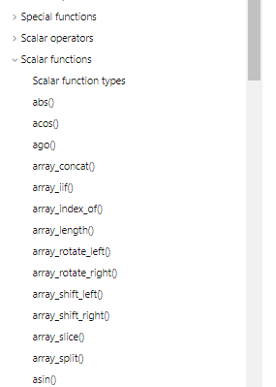
Built-In Functions
Kusto has many pre-defined, built-in functions you can use
Scalar
Aggregation
Window
Time Series Analysis
Machine Learning
Geospatial
Notes:
https://docs.microsoft.com/en-us/azure/azure-monitor/monitor-reference

Slide 56
User-defined Functions
Scalar function
A function with no inputs, or scalar inputs only, and producing a scalar output
Used wherever a scalar expression is allowed.
May only use the row context in which it is defined, and can only refer to tables (and views) that are in the accessible schema.
Tabular function
A function with no inputs, or at least one tabular input, and producing a tabular output.
Used wherever a tabular expression is allowed.
Notes:
https://docs.microsoft.com/en-us/azure/kusto/query/functions/user-defined-functions

Slide 57
Lookups
Log Analytics has various methods to perform lookups, enabling diverse sources for the lookup data and different ways to process it.
The externaldata KQL function, which enables referencing an Azure Storage file as a lookup table.
Custom tables, imported using a custom connector.
A KQL function utilizing the datatable operator, which can be updated interactively or using PowerShell.

Slide 58
Azure Sentinel Lookups
In addition to the Log Analytics methods, Azure Sentinel provides Watchlists.
Watchlists are CSV files uploaded to create lookup tables.

Slide 59
Lookup Comparison
 | Table size | Cost | Supported data | Performance | Auto-update | Manual-update | Read-Access | Write-Access | Cross-workspace
Watchlist | CSV up to 3.8MB | Free | CSV | Fastest | Coming | Coming | Any SOC user | Any SOC user | No
KQL Function | Query is limited to 2MB. | Free | Multiple | Fastest | Supported | Limited | Any SOC user | Fine-grained | No
Custom Table | Unlimited | Sentinel ingestion costs (re-ingest) | Multiple | Fast | Supported | No | Any SOC user | Any SOC user | Yes
Externaldata | Large | Azure Storage cost. | Multiple | Slower | Supported | Yes | Any SOC user | Fine-grained | Yes
Notes:
https://techcommunity.microsoft.com/t5/azure-sentinel/implementing-lookups-in-azure-sentinel/ba-p/1091306

Slide 60
Breakout Activity: Log Analytics Estimating
As a result of participating in this activity, you will better be able to planning, migrating and estimating Azure Sentinel + Log Analytics
OUTCOMES
ACTIVITY
30 minutes
Learning Adviser
Table Group Channel
As a team review WWI requirements provided in student guide
Open the whiteboard and as a team answer the provided challenge questions.
The questions are pre-loaded into the whiteboard.

Slide 61
Build Hands-on Lab: Log Analytics
As a result of participating in this lab, you will be better able to configure and design log analytics
OUTCOMES
ACTIVITY
60 minutes
Independent
Table Group Channel & CloudLabs Environment
Independently review and complete Exercises 1-4 in the Lab 1 Guide.
Login to your CloudLabs environment and work through a set of tasks you would typically follow in work associated with ingesting and integrating your customer’s data.
The Lab Guide is available in the ‘Files’ tab of the General channel. Engage your Table Group call for support and troubleshooting.

Slide 62
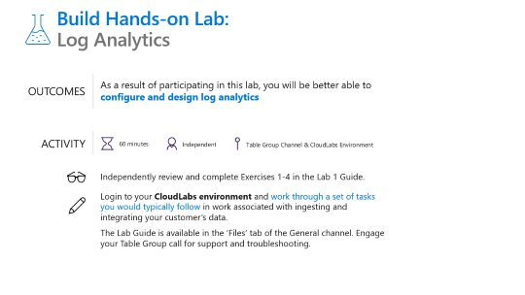
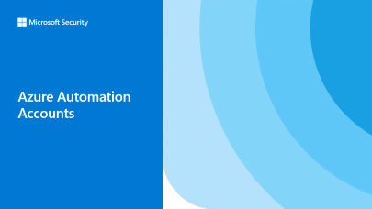



Let’s Take a Break
Take a few moments to step away.
We will come back together in 15 minutes.
We just finished | Up next, we will

Slide 63
Today’s Agenda
5
min
Welcome
25
min
Microsoft Defender for Cloud +
Azure Sentinel: Better Together
30
min
Log Analytics + Kusto Query Language
Activity: Estimating Costs
30
min
30
min
Hands-on: Log Analytics
15
min
Break
30
min
Azure Automation
30
min
Activity: Azure Automation
60
min
Break
60
min
Security Operations Center (SOC)
15
min
Break
30
min
Microsoft Defender for Cloud +
Azure Sentinel: Better Together
75
min
Hands-on: Azure Automation +
Azure Sentinel
10
min
Close

Slide 64
Azure Automation Accounts

Slide 65
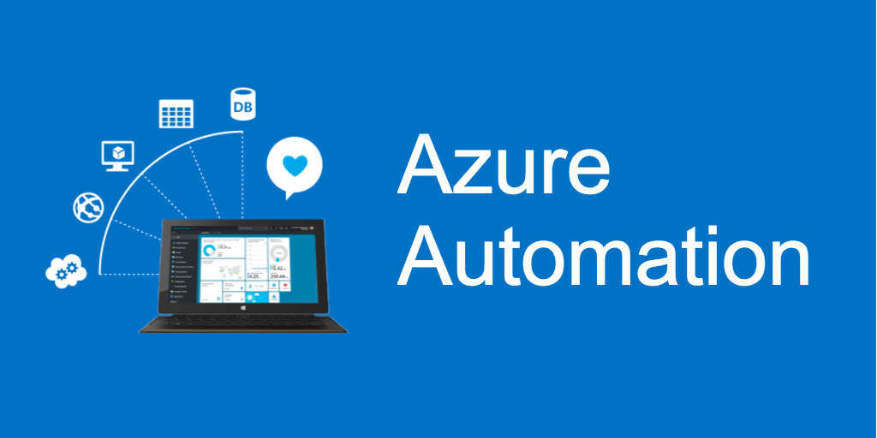
Automation Accounts
Azure Automation delivers a cloud-based automation and configuration service that supports consistent management across your Azure and non-Azure environments.
It comprises process automation, configuration management, update management, shared capabilities, and heterogeneous features.
Automation gives you complete control during deployment, operations, and decommissioning of workloads and resources.

Slide 66
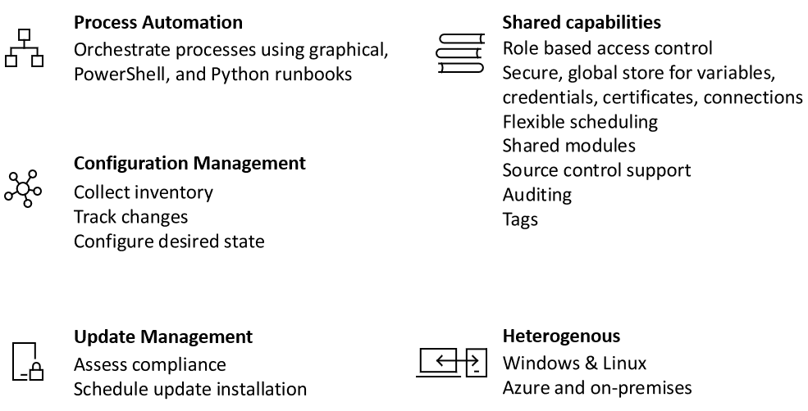
Services

Slide 67
Process Automation
Process Automation in Azure Automation allows you to automate frequent, time-consuming, and error-prone cloud management tasks.
This service helps you focus on work that adds business value. By reducing errors and boosting efficiency, it also helps to lower your operational costs.
The service allows you to author runbooks graphically, in PowerShell, or using Python.
By using a Hybrid Runbook Worker, you can unify management by orchestrating across on-premises environments.
Webhooks let you fulfill requests and ensure continuous delivery and operations by triggering automation from ITSM, DevOps, and monitoring systems.

Slide 68
Hybrid Runbook Worker
Runbooks in Azure Automation might not have access to resources in other clouds or in your on-premises environment because they run on the Azure cloud platform.
You can use the Hybrid Runbook Worker feature of Azure Automation to run runbooks directly on the machine that's hosting the role and against resources in the environment to manage those local resources. Runbooks are stored and managed in Azure Automation and then delivered to one or more assigned machines.
The maximum number of Hybrid Worker groups per Automation Account is 4000, and is applicable for both system & user hybrid workers. If you have more than 4,000 machines to manage, we recommend creating another Automation account.
There are two types of Runbook Workers:
System - Supports a set of hidden runbooks used by the Update Management feature that are designed to install user-specified updates on Windows and Linux machines.
User - Supports user-defined runbooks intended to run directly on the Windows and Linux machine that are members of one or more Runbook Worker groups.

Slide 69
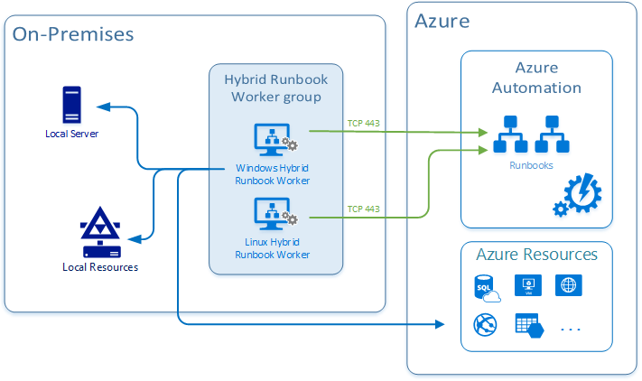
Hybrid Runbook Worker Architecture
When you start a runbook on a user Hybrid Runbook Worker, you specify the group that it runs on. Each worker in the group polls Azure Automation to see if any jobs are available. If a job is available, the first worker to get the job takes it.

Slide 70
Hybrid Runbook Worker Architecture (Cont)
Hybrid worker works on a polling mechanism (every 30 secs) and follows an order of first-come, first-serve.
Depending on when a job was pushed, whichever hybrid worker pings the Automation service picks up the job.
A single hybrid worker can generally pick up four jobs per ping (that is, every 30 seconds).
If your rate of pushing jobs is higher than four per 30 seconds, then there is a high possibility another hybrid worker in the Hybrid Runbook Worker group picked up the job.
To control the distribution of runbooks on Hybrid Runbook Workers and when or how the jobs are triggered, you can register the hybrid worker against different Hybrid Runbook Worker groups within your Automation account.
Target the jobs against the specific group or groups in order to support your execution arrangement.

Slide 71
Configuration Management
Configuration Management in Azure Automation allows access to two features:
Change Tracking and Inventory
Azure Automation State Configuration
Change Tracking and Inventory combines change tracking and inventory functions to allow you to track virtual machine and server infrastructure changes. The service supports change tracking across services, daemons, software, registry, and files.
Azure Automation State Configuration is a cloud-based feature for PowerShell desired state configuration (DSC) that provides services for enterprise environments

Slide 72
Update Management
Azure Automation includes the Update Management feature for Windows and Linux systems across hybrid environments.
Update Management gives you visibility into update compliance across Azure and other clouds, and on-premises.
The feature allows you to create scheduled deployments that orchestrate the installation of updates within a defined maintenance window.
If an update shouldn't be installed on a machine, you can use Update Management functionality to exclude it from a deployment.

Slide 73
Shared Capabilities
Azure Automation consists of a set of shared resources that make it easier to automate and configure your environments at scale.
Schedules - Trigger Automation operations at predefined times.
Modules - Manage Azure and other systems. You can import modules into the Automation account for Microsoft, third-party, community, and custom-defined cmdlets and DSC resources.
Modules gallery - Supports native integration with the PowerShell Gallery to let you view runbooks and import them into the Automation account. The gallery allows you to quickly get started integrating and authoring your processes from PowerShell gallery and Microsoft Script Center.
Python 2 packages - Support Python 2 runbooks for your Automation account.
Credentials - Securely store sensitive information that runbooks and configurations can use at runtime.
Connections - Store name-value pairs of common information for connections to systems. The module author defines connections in runbooks and configurations for use at runtime.
Certificates - Define information to be used in authentication and securing of deployed resources when accessed by runbooks or DSC configurations at runtime.
Variables - Hold content that can be used across runbooks and configurations. You can change variable values without having to modify any of the runbooks or configurations that reference them.

Slide 74
Common Scenarios
Write runbooks - Author PowerShell, PowerShell Workflow, graphical, Python 2, and DSC runbooks in common languages.
Build and deploy resources - Deploy virtual machines across a hybrid environment using runbooks and Azure Resource Manager templates. Integrate into development tools, such as Jenkins and Azure DevOps.
Configure VMs - Assess and configure Windows and Linux machines with configurations for the infrastructure and application.
Share knowledge - Transfer knowledge into the system on how your organization delivers and maintains workloads.
Retrieve inventory - Get a complete inventory of deployed resources for targeting, reporting, and compliance.
Find changes - Identify changes that can cause misconfiguration and improve operational compliance.
Monitor - Isolate machine changes that are causing issues and remediate or escalate them to management systems.
Protect - Quarantine machines if security alerts are raised. Set in-guest requirements.
Govern - Set up Azure RBAC for teams. Recover unused resources.

Slide 75
Log Analytics + Linking
All monitoring solutions require a Log Analytics workspace to store data collected by the solution and to host its log searches and views. Some solutions also require an Automation account to contain runbooks and related resources.
The workspace and account must meet the following requirements.
Each installation of a solution can only use one Log Analytics workspace and one Automation account. You can install the solution separately into multiple workspaces.
If a solution requires an Automation account, then the Log Analytics workspace and Automation account must be linked to one another. A Log Analytics workspace may only be linked to one Automation account, and an Automation account may only be linked to one Log Analytics workspace.
When you install a solution through Azure Marketplace, you're prompted for a workspace and Automation account. The link between them is created if they aren't already linked.

Slide 76
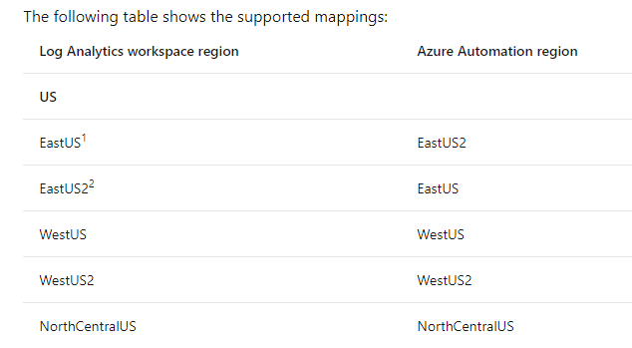
Linking + Regions
In Azure Automation, you can enable the Update Management, Change Tracking and Inventory, and Start/Stop VMs during off-hours features for your servers and virtual machines.
These features have a dependency on a Log Analytics workspace, and therefore require linking the workspace with an Automation account.
However, only certain regions are supported to link them together.
In general, the mapping is not applicable if you plan to link an Automation account to a workspace that won't have these features enabled.
Notes:
https://docs.microsoft.com/en-us/azure/automation/how-to/region-mappings

Slide 77
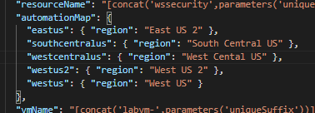
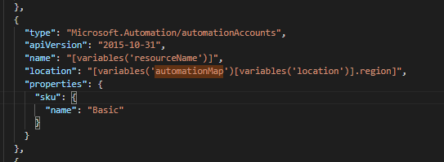
Deploying with ARM
Use mappings via variables and arrays:

Slide 78
Question…
Does Azure Automation support user accounts with MFA enabled?
Notes:
Azure Automation does NOT support user accounts that use multi-factor authentication
https://docs.microsoft.com/en-us/azure/automation/shared-resources/credentials?view=o365-worldwide

Slide 79
Question…
Does Azure Automation support Day Light Savings time?
Can you edit encrypted variables in the Azure Portal?
How do you remove encryption for a variable?
Notes:
Azure Automation supports Daylight Savings Time and schedules it appropriately for automation operations.
https://docs.microsoft.com/en-us/azure/automation/shared-resources/schedules?view=o365-worldwide
Once you have saved an encrypted variable, it can't be viewed in the portal. It can only be updated.
If you want to remove the encryption for a variable, you must delete the variable and recreate it as unencrypted.
https://docs.microsoft.com/en-us/azure/automation/shared-resources/variables?view=o365-worldwide

Slide 80
Question…
What is the minimum time interval of change tracking in Log Analytics / Azure Automation?
Notes:
While the agent can track changes down to a 10-second interval, the data still takes a few minutes to display in the Azure portal. Changes that occur during the time to display in the portal are still tracked and logged.
https://docs.microsoft.com/en-us/azure/automation/change-tracking/overview?view=o365-worldwide

Slide 81
Breakout Activity: Log Analytics + Azure Automation
As a result of participating in this activity, you will better be able to Design remediation actions for cloud and Azure based resources
OUTCOMES
ACTIVITY
30 minutes
Learning Adviser
Table Group Channel
As a team review WWI requirements provided in student guide
Open the whiteboard and as a team answer the provided challenge questions.
The questions are pre-loaded into the whiteboard.

Slide 82
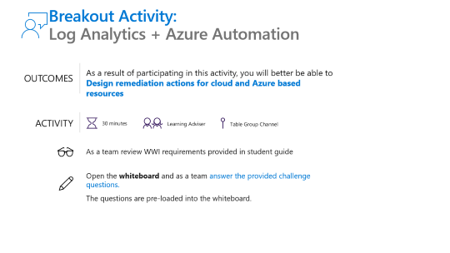

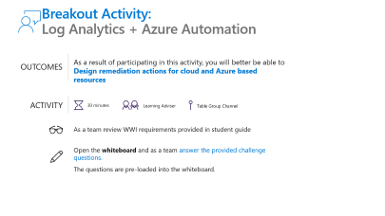


Let’s Take a Break
Take a few moments to step away.
We will come back together in 60 minutes.
We just finished | Up next, we will

Slide 83
Today’s Agenda
5
min
Welcome
25
min
Microsoft Defender for Cloud +
Azure Sentinel: Better Together
30
min
Log Analytics + Kusto Query Language
Activity: Estimating Costs
30
min
30
min
Hands-on: Log Analytics
15
min
Break
30
min
Azure Automation
30
min
Activity: Azure Automation
60
min
Break
60
min
Security Operations Center (SOC)
15
min
Break
30
min
Microsoft Defender for Cloud +
Azure Sentinel: Better Together
75
min
Hands-on: Azure Automation +
Azure Sentinel
10
min
Close

Slide 84
Security Operations Center

Slide 85
The Golden Hour
The golden hour, also known as golden time, refers to the period of time following a traumatic injury during which there is the highest likelihood that prompt medical and surgical treatment will prevent death.
Expression used to show how important it is to respond to/repair a cybersecurity threat in the first hour.
In the last few years (WannaCry, Petya, Bad Rabbit, etc.), the "golden hour" concept just doesn't hold.
We need to do our best to prevent attacks from happening in the first place!
Notes:
The Golden Hour remake - Defining metrics for a successful security operations - Microsoft Tech Community

Slide 86
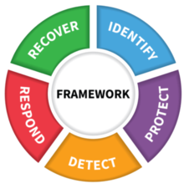
Security Operations Center
Security operations maintain and restores the security assurances of the system as live adversaries attack it. The tasks of security operations are described well by the NIST Cybersecurity Framework functions of Detect, Respond, and Recover.
Detect - Security operations must detect the presence of adversaries in the system, who are incented to stay hidden in most cases as this allows them to achieve their objectives unimpeded. This can take the form of reacting to an alert of suspicious activity or proactively hunting for anomalous events in the enterprise activity logs.
Respond – Upon detection of potential adversary action or campaign, security operations must rapidly investigate to identify whether it is an actual attack (true positive) or a false alarm (false positive) and then enumerate the scope and goal of the adversary operation.
Recover – The ultimate goal of security operations is to preserve or restore the security assurances (confidentiality, integrity, availability) of business services during and after an attack.
Notes:
Security operations in Azure | Microsoft Docs

Slide 87

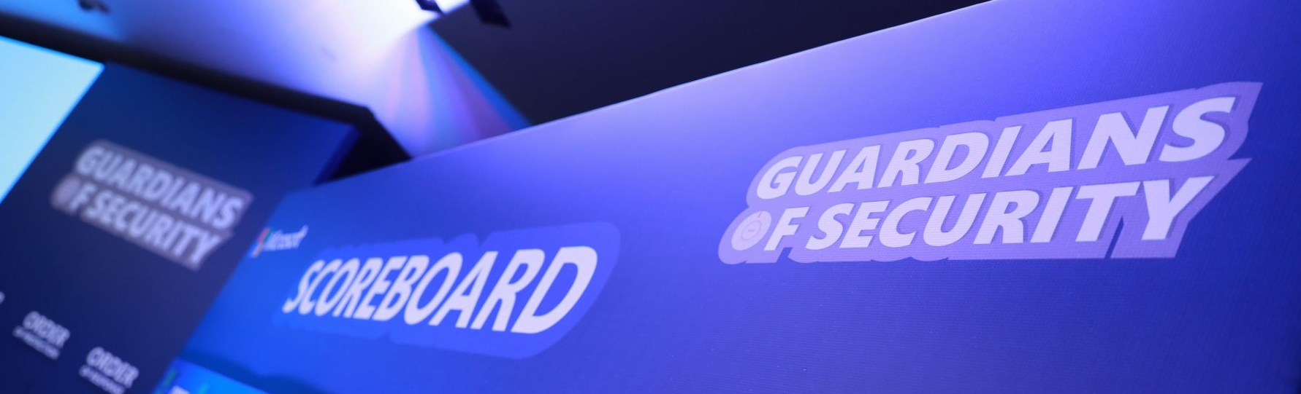
Doing a good job?
So how do you know that you are doing a good job?
My job is to "clean" the queue (SIEM/Product Specific)
We are overwhelmed anyway so we are doing what we can.
As long as there is no breach on my network, I am doing my job
As long as my company is not on the front page of the newspaper I’m fine

Slide 88
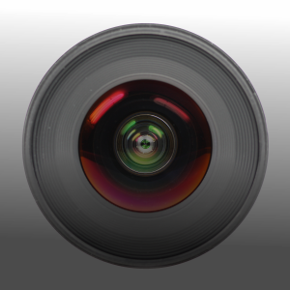
Focus Areas
Known knowns - Could be solved or dramatically reduced by implementing a vulnerability management program, exploit mitigations, secure configuration (fix all misconfiguration, security hardening), and by building secure perimeters (network perimeter, physical devices, application control, etc.).
Known unknowns - In this area our mindset should be, "We haven't seen this before, but we have the tools to stop it". We should take into consideration solutions like machine learning-driven next-generation antimalware, automatic containment (i.e., conditional access), and automatic investigation and remediation solutions to reduce risk as fast as possible
Unknown unknowns - In this area we should focus on visibility and expert assistance: best-in-class endpoint detection and response (EDR) solution and managed detection and response (MDR) services that have your back
Notes:
The Golden Hour remake - Defining metrics for a successful security operations - Microsoft Tech Community

Slide 89
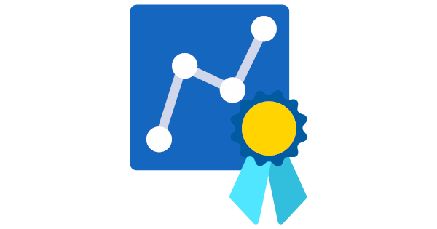
Success Metrics
Security operators, incident responders, or security analysts should all have an easy way to evaluate their work. Common KPIs include:
Mean time to detect - The average time it takes to recognize a threat
Mean time to Investigate - The average time it takes to analyze the potential threat and identify if any further response actions are needed
Mean time to respond - the average time it takes to response and stop a potential threat from spreading or creating any damage.
Mean time to repair/recover - The average time it takes to restore to normal operations

Slide 90
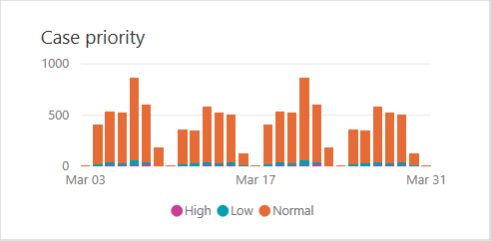
Prioritizing Alert and Log Interaction
Ensure that you are integrating critical security alerts and logs into SIEMs without introducing a high volume of low value data.
Introducing too much low value data can increase SIEM cost, increase noise and false positives, and lower performance.
The data you collect should be focused on supporting one or more of these operations activities:
Alerts (detections from existing tools or data required for generating custom alerts)
Investigation of an incident (for example, required for common queries)
Proactive hunting activities
Notes:
Security operations in Azure | Microsoft Docs

Slide 91
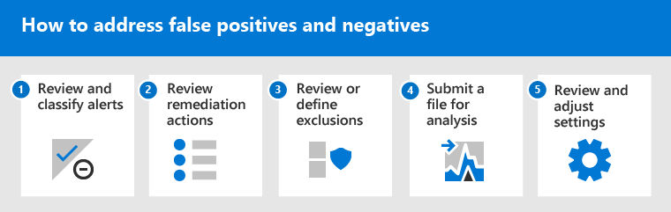
False Positive and Negatives
In endpoint protection solutions, a false positive is an entity, such as a file or a process, that was detected and identified as malicious, even though the entity isn't actually a threat.
A false negative is an entity that was not detected as a threat, even though it actually is malicious.
Notes:
Address false positives/negatives in Microsoft Defender for Endpoint | Microsoft Docs

Slide 92
Investigation Examples
Phishing – https://docs.microsoft.com/en-us/security/compass/incident-response-playbook-phishing
Password Spray – https://docs.microsoft.com/en-us/security/compass/incident-response-playbook-password-spray
App Consent - https://docs.microsoft.com/en-us/security/compass/incident-response-playbook-app-consent
Notes:
https://docs.microsoft.com/en-us/security/compass/incident-response-playbook-phishing
https://docs.microsoft.com/en-us/security/compass/incident-response-playbook-password-spray
https://docs.microsoft.com/en-us/security/compass/incident-response-playbook-app-consent

Slide 93
Microsoft + Security Operations

Slide 94
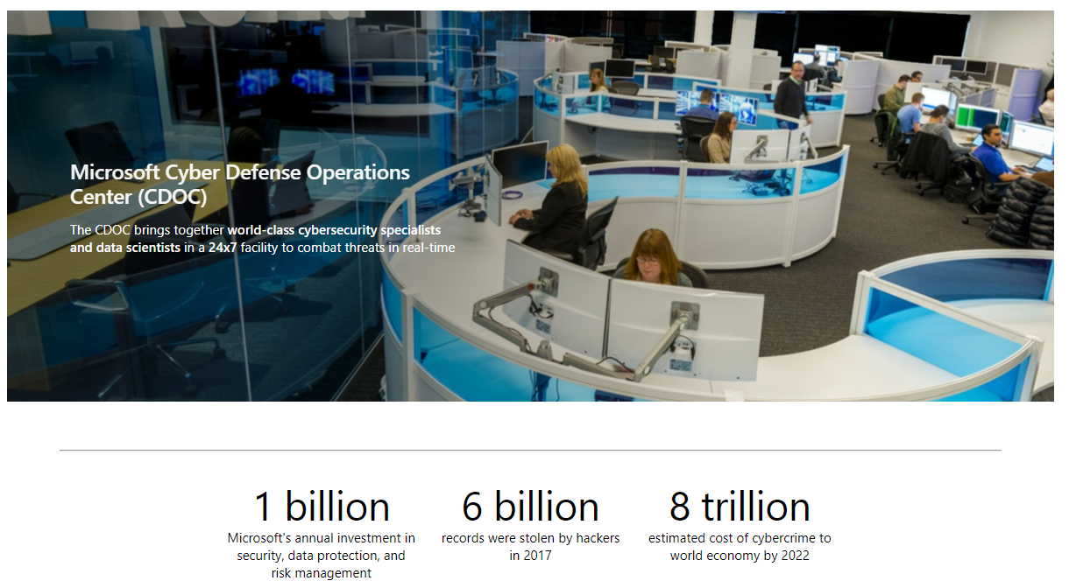
Microsoft Cyber Defense Operations Center (CDOC)
Notes:
https://www.microsoft.com/en-us/msrc/cdoc

Slide 95


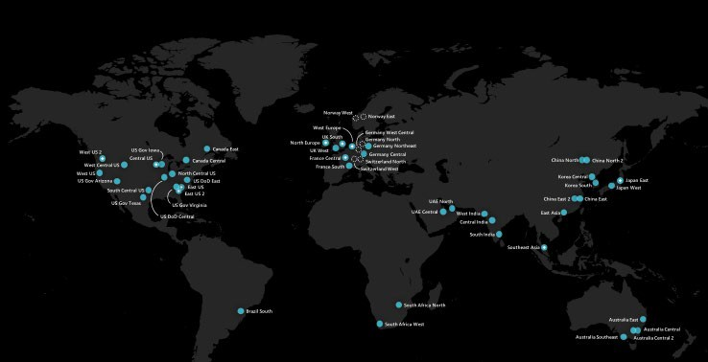
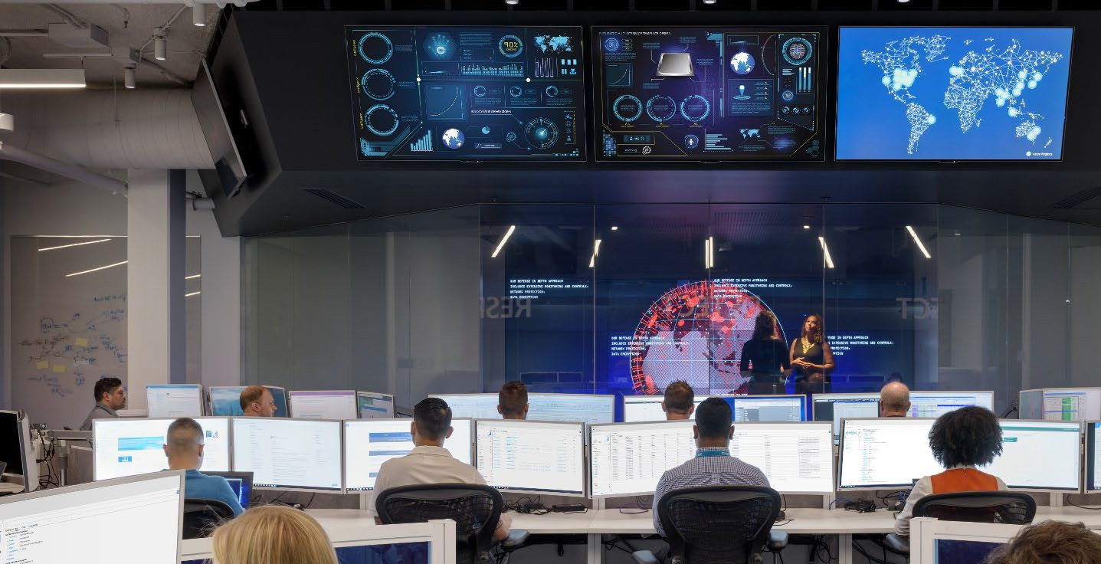






GlobAL
Secure & Compliant
Industrial Facilities
60+
Azure regions, the largest geographical footprint of any cloud provider
8th
Generation of Design, building Datacenters since 1989
Multiple Generations
of DCs in Operation
92
Compliance offerings
Electrical Power Monitoring (EPMS) Building Management (BMS) HVAC Systems
Water Chilling & Fire
Suppression Systems
Diverse Personnel (MS and Non-MS)
Windows & Linux embedded devices, workstations and servers

Slide 96

CDOC
The Cyber Defense Operations Center brings together security response experts from across the company to help protect, detect, and respond to threats in real-time. Staffed with dedicated teams 24x7, the Center has direct access to thousands of security professionals, data scientists, and product engineers throughout Microsoft to ensure rapid response and resolution to security threats.
​
Informed by trillions of data points across an extensive network of sensors, devices, authentications, and communications, the Center employs automated software, machine learning, behavioral analysis, and forensics to create an intelligent security graph.
This threat intelligence insight helps our teams connect the dots, then counter with strong containment and coordinated remediation.

Slide 97


Slide 98


Slide 99

SOC + Traditional Approach
This is the common model where all event data is fed into an on-premises SIEM where analytics are performed on the data (primarily static queries that were refined over time).

Slide 100

SOC + Modern Approach
A model designed to optimize both breadth (unified view of all events) and depth capabilities.

Slide 101


Slide 102
SOC + Tools + Migrating
Expect transitioning to cloud analytics like Azure Sentinel will often include a side-by-side configuration with an existing legacy SIEM.
Short-term transition state—For organizations that are committed to rapidly retiring a legacy SIEM in favor of Azure Sentinel (often to reduce cost/complexity) and need operational continuity during this short bridge period.
Medium-term coexistence—For organizations with significant investment into an on-premises SIEM and/or a longer-term plan for cloud migration. These organization recognize the power of Data Gravity—placing analytics closer to the cloud data will avoid costs and challenges of transferring logs to/from the cloud.
Managing the SOC investigations across the SIEM platforms can be accomplished with reasonable efficiency using either a case management tool or the Microsoft Graph Security API (synchronizing Alerts between the two SIEM platforms).

Slide 103
SOC + Business
Business context (to the SOC) —The SOC needs to understand what is most important to the organization so the team can apply that context to fluid real-time security situations. What would have the most negative impact on the business?
Joint practice exercises (with the SOC)—Business leaders should regularly join the SOC in practicing response to major incidents. This builds the muscle memory and relationships that are critical to fast and effective decision making in the high pressure of real incidents, reducing organizational risk. This practice also reduces risk by exposing gaps and assumptions in the process that can be fixed prior to a real incident.
Major incidents updates (from the SOC)—The SOC should provide updates to business stakeholders for major incidents as they happen. This allows business leaders to understand their risk and take both proactive and reactive steps to manage that risk.
Business intelligence (from the SOC)—Sometimes the SOC finds that adversaries are targeting a system or data set that isn’t expected. As the SOC discovers the targets of attacks, they should share these with business leaders as these signals may trigger insight for business leaders.

Slide 104

SOC + Culture
Use your human talent wisely—Our people are the most valuable asset we have in the SOC and we can’t afford to waste their time on repetitive thoughtless tasks that can be automated.
Teamwork—We’ve learned that we can’t tolerate the “lone hero” mindset in the SOC, nobody is as smart as all of us together. Teamwork makes a high-pressure working environment like the SOC much more fun, enjoyable, and productive when everyone knows they’re on the same team and everyone has each other’s back. We design our processes and tools to divide up tasks into specialties and to encourage people to share insights, coordinate and check each other’s work, and constantly learn from each other.
Shift left mindset—To get and stay ahead of cybercriminals and hackers who constantly evolve their techniques, we must continuously improve and shift our activities “left” in the attack timeline. We focus on speed and efficiency to try and get “faster than the speed of attack” by looking at ways we could have detected attacks earlier and responded more quickly.

Slide 105

SOC + People
People are the most valuable asset in the SOC—their experience, skill, insight, creativity, and resourcefulness are what makes our SOC effective.
Our SOC management team spends a lot of time thinking about how to ensure our people are set up with what they need to succeed and stay engaged.
As we’ve improved our processes, we’ve been able to decrease the time it takes to ramp people up and increase employee enjoyment of their jobs.
Two aspects of how to set up people in the SOC for success:
Empower humans with automation.
Microsoft SOC teams and tiers model.

Slide 106

SOC + Automation
Automation is not about using efficiency to remove humans from the process—it is about empowering humans.
Think about how we can automate repetitive tasks from the analyst’s job, so they can focus on the complex problems that people are uniquely able to solve.
Automation empowers humans to do more in the SOC by increasing response speed and capturing human expertise.
The toil our staff experiences comes mostly from repetitive tasks and repetitive tasks come from either attackers or defenders doing the same things over and over.
Repetitive tasks are ideal candidates for automation.

Slide 107

SOC + Teams and Tiers
Operates with three tiers of analysts plus automation:

Slide 108
SOC + Tier 1
This team is the primary front line for and focuses on high-speed remediation over a large volume of incidents.
Tier 1 analysts respond to a very specific set of alert sources and follow prescriptive instructions to investigate, remediate, and document the incidents.
The rule of thumb for alerts that Tier 1 handles is that it can be typically remediated within seconds to minutes.
The incidents will be escalated to Tier 2 if the incident isn’t covered by a documented Tier 1 procedure or it requires involved/advanced remediation

Slide 109
SOC + Tier 2
This team is focused on incidents that require deeper analysis and remediation.
Many Tier 2 incidents have been escalated from Tier 1 analysts, but Tier 2 also directly monitors alerts for sensitive assets and known attacker campaigns.
These incidents are usually more complex and require an approach that is still structured, but much more flexible than Tier 1 procedures.
Additionally, some Tier 2 analysts also proactively hunt for adversaries (typically using lower priority alerts from the same Microsoft Threat Protection tools they use to manage reactive incidents).

Slide 110
SOC + Tier 3
This team is focused primarily on advanced hunting and sophisticated analysis to identify anomalies that may indicate advanced adversaries.
Most incidents are remediated at Tiers 1 and 2 (96 percent) and only unprecedented findings or deviations from norms are escalated to Tier 3 teams.
Tier 3 team members have a high degree of freedom to bring their different skills, backgrounds, and approaches to the goal of ferreting out red team/hidden adversaries.
Tier 3 team members have backgrounds as security professionals, data scientists, intelligence analysts, and more.
These teams use different tools (Microsoft, custom, and third-party) to sift through a number of different datasets to uncover hidden adversary activity.
A favorite of many analysts is the use of Kusto Query Language (KQL) queries across Microsoft Threat Protection tool datasets.

Slide 111
SOC + Tier 3 Functions
Major incident engineering—Handles escalation of incidents from Tier 2. These virtual teams are created as needed to support the duration of the incident and often include both reactive investigations, as well as proactive hunting for additional adversary presence.
External adversary research and threat analysis—Focuses on hunting for adversaries using existing tools and data sources, as well as signals from various external intelligence sources. The team is focused on both hunting for undiscovered adversaries as well as creating and refining alerts and automation.
Purple team operations—A temporary duty assignment where Tier 3 analysts (blue team) are paired with our in-house attack team members (red team) as they perform authorized attacks. We found this purple (red+blue) activity results in high-value learning by both teams, strengthening our overall security posture and resilience. This team is also responsible for the critical task of coordinating with red team to deconflict whether a detection is an authorized red team or a live attacker.
Future operations team—Focuses on future-proofing our technology and processes by building and testing new capabilities.

Slide 112

SOC + Training + Retention
The apprenticeship model to be most effective at rapidly and consistently building skills. The readiness process focuses on building understanding and competency in three domains:
Technical tools/capabilities.
Our organization (mission and assets being protected).
Attackers (motivations, tools, techniques, habits, etc.).
We supplement this apprenticeship model with structured, formal training on topics, such as new products or features and SOC procedures.
We also encourage attendance at conferences and work hard to ensure our staffing model supports these and other learning opportunities, so they aren’t empty promises.
This approach has been successful allowing us to train new Tier 1 analysts in approximately 10–12 weeks and we’re continuously looking for ways to improve our readiness processes.
In addition, our staffing approach has been critical at mitigating burnout risk.

Slide 113
SOC + Metrics
Time to acknowledge (TTA)—Responsiveness is one of the few elements the SOC has direct control over. We measure the time between an alert being raised (“light starts to blink”) and when an analyst acknowledges that alert and begins the investigation.
Time to remediate (TTR)—Much like many SOCs, we track the time to remediate an incident to ensure we’re limiting the time attackers have access to our environment, which drive effectiveness and efficiencies in our SOC processes and tools.
Incidents remediated (manually/with automation)—We measure how many incidents are remediated manually and how many are resolved with automation. This ensures our staffing levels are appropriate and measures the effectiveness of our automation technology.
Escalations between each tier—We track how many incidents escalated between tiers to ensure we accurately capture the workload for each tier. For example, we need to ensure that Tier 1 work on an escalated incident isn’t fully attributed to Tier 2.

Slide 114





Let’s Take a Break
Take a few moments to step away.
We will come back together in 10 minutes.
We just finished | Up next, we will

Slide 115
Today’s Agenda
5
min
Welcome
25
min
Microsoft Defender for Cloud +
Azure Sentinel: Better Together
30
min
Log Analytics + Kusto Query Language
Activity: Estimating Costs
30
min
30
min
Hands-on: Log Analytics
15
min
Break
30
min
Azure Automation
30
min
Activity: Azure Automation
60
min
Break
60
min
Security Operations Center (SOC)
15
min
Break
30
min
Microsoft Defender for Cloud +
Azure Sentinel: Better Together
75
min
Hands-on: Azure Automation +
Azure Sentinel
10
min
Close

Slide 116
Microsoft Defender for Cloud + Azure Sentinel -Better together!

Slide 117

Microsoft Defender for Cloud + Azure Sentinel
How does Azure Sentinel work with Microsoft Defender for Cloud to provide Analysts the tools they need?
How does Azure Sentinel improve SOC efficiency?
Integration of Threat Intelligence Data
Microsoft Intelligent Security Graph
Microsoft Threat Intelligence Center
Notes:
https://www.microsoft.com/en-us/itshowcase/microsoft-uses-threat-intelligence-to-protect-detect-and-respond-to-threats

Slide 118
Microsoft Intelligent Security Graph
The Microsoft Intelligent Security Graph is foundational for embedding security protection in Office 365, Azure, Windows, and other products.
The graph will gather signals from the entire ecosystem of Microsoft and industry-leading commercial and consumer services, security monitoring and operations services and products, Windows devices, Azure, and Office Security and Compliance services.
It enriches those signals with threat, customer, industry, and operational context. Signals in the graph generate insights and context that are infused into Office 365, Azure, Windows, and other products and services.
Microsoft security analysts in the Cyber Defense Operations Center (CDOC)—a facility that unites security response experts from across the company to protect, detect, and respond to threats—use the Intelligent Security Graph.
Faster detection is essential. The Intelligent Security Graph enables faster, more comprehensive threat discovery and response.

Slide 119
Microsoft Threat Intelligence Center (MSTIC)
The Microsoft Threat Intelligence Center (MSTIC) team—one of the main producers of threat intelligence at Microsoft—collects the threat intelligence that’s infused into products and services. MSTIC aggregates data from sources such as:
First-party threat intelligence feeds (honeypots, malicious IP addresses, botnets, malware detonation feeds)
Third-party sources (threat intelligence feeds, reference/lookup data)
Analysts/human-based observation and intelligence collection

Slide 120


















Microsoft Datacenters and SOC
Data Collection
Correlation & Detection
Incident Response
Critical Infrastructure Environment
Azure Sentinel
Microsoft SOC
Domain controller | AD | Firewall
Physical Hosts | VMs | Network Routers
Connect Diverse Sources
Orchestration
Log Search Across Data Sources
Industrial Control Systems & Industrial IoT Devices (Azure Defender for IoT)
OT+IT Playbooks
Alert Publisher API
Automation
Microsoft Managed Secure Devices
Alerts with Reduced Noise
Case Management
ML Powered Detections Bring Your Own ML
Physical Access
Investigation

Slide 121
Datacenter Security Monitoring & Response System
Improved critical environment Inventory quality for risk-based analysis
Correlate security-significant events across multiple sources
Advanced detections for ICS networks for known malware, botnet, and command and control traffic
Threat Detection with ML Support for Insider threat detection scenario via UEBA
OT+IT Incident Response Processes & Playbooks using LogicApps integrated with Microsoft SOC
Detect Suspicious/Anomalous activity while reducing noise

Slide 122



























TRITON Kill Chain
Attack on Petrochemical Facility
1
2 3
4
Steal OT credentials
CORPORATE
Remote access to OT network
DMZ
Reprogram safety PLC
PLC & RTU
Disable safety PLC & launch 2nd cyberattack
SCADA
SENSORS & ACTUATOR
Workstation
HMI
Engineering Workstation
Internet
TriStation
col
Proto
Historian
Historian
PLC
Sensors
Actuations
App server
Network
Device
Network
Historian
Printer
Device
RTU
Other
IT OT

Slide 123


Challenges to detecting TRITON
Data availability
Collect logs from multiple sources
Connecting the dots
Connect IT events to OT occurrence
Understanding OT
Apply knowledge of OT systems
Identifying real threats
Detect and prioritize threats from a sea of data

Slide 124
Incident Integration
Incident integration allows you to stream all Microsoft 365 Defender incidents into Azure Sentinel and keep them synchronized between both portals.
Incidents from Microsoft 365 Defender (formerly known as Microsoft Threat Protection or MTP) include all associated alerts, entities, and relevant information, providing you with enough context to perform triage and preliminary investigation in Azure Sentinel.
Once in Sentinel, Incidents will remain bi-directionally synced with Microsoft 365 Defender, allowing you to take advantage of the benefits of both portals in your incident investigation.
Microsoft 365 Defender enriches and groups alerts from multiple Microsoft 365 products, both reducing the size of the SOC’s incident queue and shortening the time to resolve.
Microsoft Defender for Endpoint (formerly Microsoft Defender ATP)
Microsoft Defender for Identity (formerly Azure ATP)
Microsoft Defender for Office 365 (formerly Office 365 ATP)
Microsoft Cloud App Security
Notes:
Microsoft 365 Defender integration with Azure Sentinel | Microsoft Docs

Slide 125
Connectors
Microsoft 365 Defender connector also lets you stream advanced hunting events from Microsoft 365 Defender and its component services into Azure Sentinel.
These tables are built on the same schema that is used in the Microsoft 365 Defender portal, giving you complete access to the full set of advanced hunting events.
Advantages include:
Easily copy your existing Microsoft Defender for Endpoint advanced hunting queries into Azure Sentinel.
Use the raw event logs to provide further insights for your alerts, hunting, and investigation, and correlate these events with events from other data sources in Azure Sentinel.
Store the logs with increased retention, beyond Microsoft Defender for Endpoint or Microsoft 365 Defender’s default retention of 30 days. You can do so by configuring the retention of your workspace or by configuring per-table retention in Log Analytics.
Notes:
Microsoft 365 Defender integration with Azure Sentinel | Microsoft Docs

Slide 126

Sentinel Community
Microsoft 365 Defender connector also lets you stream advanced hunting events from Microsoft 365 Defender and its component services into Azure Sentinel.
These tables are built on the same schema that is used in the Microsoft 365 Defender portal, giving you complete access to the full set of advanced hunting events.
Advantages include:
Easily copy your existing Microsoft Defender for Endpoint advanced hunting queries into Azure Sentinel.
Use the raw event logs to provide further insights for your alerts, hunting, and investigation, and correlate these events with events from other data sources in Azure Sentinel.
Store the logs with increased retention, beyond Microsoft Defender for Endpoint or Microsoft 365 Defender’s default retention of 30 days. You can do so by configuring the retention of your workspace or by configuring per-table retention in Log Analytics.
Notes:
Microsoft 365 Defender integration with Azure Sentinel | Microsoft Docs

Slide 127

End to End Investigations
As the analyst builds this understanding, they must capture a complete record with their conclusions and reasoning/evidence for future use (case reviews, analyst self-education, re-opening cases that are later linked to active attacks, etc.). They capture the common, most relevant details quickly into the case such as:
Alert info: Alert links and Alert timeline
Machine info: Name and ID
User info
Event info
Detection source
Download source
File creation info
Process creation
Installation/Persistence method(s)
Network communication
Dropped files

Slide 128

Hunting - ABH
Assume breach, zero-trust.
Hunting is used to develop a high enough level of confidence that they understand the story and scope of the attack.
ABH - Always Be Hunting.
Azure Sentinel provides the Hunting blade to execute common queries and see the differential between the current execution value and the last execution value.
Can be very helpful in determining if you have an active attack occurring.

Slide 129
KQL Unions & Joins
Hunting involves taking data from multiple tables and combining it to get a big picture view of an entity.
In most cases, Azure Sentinel Incidents provide you with enough KQL templates to get you to where you need to be, however, in some instances, you may need to write your own.
This is especially true with custom logs and external table joins (as would be the case with anonymized privacy-based data) or with sliding window queries.
union isfuzzy command is used to prevent a query from failing, even in the case of a failure in a specific section of the query – since it is run on each query separately.

Slide 130

KQL Unions : Example
This query uses an external lookup with IP Address of compromise along with a union of various tables where the columns are mapped to a normalized schema and then joined with the Indicator value.
Notes:
https://techcommunity.microsoft.com/t5/azure-sentinel/azure-sentinel-correlation-rules-the-join-kql-operator/ba-p/1041500

Slide 131


KQL Joins : Example
How do you get data in two different timespans?
The "where" clause serves to implement the time framing correctly
The purple condition ensures that no more than lookback time separated the two events, compensating for the fact that we query the reference event for slightly more than 24 hours.
The blue condition ensures that user deletion happened after the user addition.
Notes:
https://techcommunity.microsoft.com/t5/azure-sentinel/azure-sentinel-correlation-rules-the-join-kql-operator/ba-p/1041500

Slide 132

SOC + Day In The Life of An Analyst + Part I
Alert appears in the queue—After a threat detection tool detects a likely attack, an incident is automatically created. The Mean Time to Acknowledge (MTTA) measurement of SOC responsiveness begins with this timestamp.
Own and orient—The analyst on shift begins by taking ownership of the case and reading through the information available in the case management tool. The timestamp for this is the end of the MTTA responsiveness measurement and begins the Mean Time to Remediate (MTTR) measurement.
Check out the host—Typically, the first priority is to identify affected endpoints so analysts can rapidly get deep insight. Our SOC relies on the Endpoint Detection and Response (EDR) of Microsoft Defender.
Scope out and fill in the timeline—The analyst then builds a full picture and timeline of the related chain of events that led to the alert (which may be an adversary’s attack operation or false alarm positive) by following leads from the first host alert.

Slide 133

Responding
The specific response steps are very dependent on the nature of the attack, but the most common procedures used by our analysts include:
Client endpoints—SOC analysts can isolate a computer and contact the user directly (or IT operations/helpdesk) to have them initiate a reinstallation procedure.
Server or applications—SOC analysts typically work with IT operations and/or application owners to arrange rapid remediation of these resources.
User accounts—We typically reclaim control of these by disabling the account and resetting password for compromised accounts (though these procedures are evolving as a large amount of our users are mostly password-less using Windows Hello or another form of MFA). Our analysts also explicitly expire all authentication tokens for the user with Microsoft Cloud App Security.
Analysts also review the multi-factor phone number and device enrollment to ensure it hasn’t been hijacked (often contacting the user), and reset this information as needed.

Slide 134
Responding (Cont)
Service Accounts—Because of the high risk of service/business impact, SOC analysts work with the service account owner of record (falling back on IT operations as needed) to arrange rapid remediation of these resources.
Emails—The attack/phishing emails are deleted (and sometimes cleared to prevent recovering of deleted emails), but we always save a copy of original email in the case notes for later search and analysis (headers, content, scripts/attachments, etc.).
Other—Custom actions can also be executed based on the nature of the attack such as revoking application tokens, reconfiguring servers and services, and more.

Slide 135

SOC + Day In The Life of An Analyst + Part II
Decide and act—As the analyst develops a high enough level of confidence that they understand the story and scope of the attack, they quickly shift to planning and executing cleanup actions. While this appears as a separate step in this particular description, our analysts often execute on cleanup operations as they find them.
Post-incident cleanup—Because lessons aren’t actually “learned” unless they change future actions, our analysts always integrate any useful information learned from the investigation back into our systems. Analysts capture these learnings so that we avoid repeating manual work in the future and can rapidly see connections between past and future incidents by the same threat actors. This can take a number of forms, but common procedures include:

Slide 136

Post-Incident
Analysts capture learnings so as to avoid repeating manual work in the future and can rapidly see connections between past and future incidents by the same threat actors.
Common procedures include:
Indicators of Compromise (IoCs)—Our analysts record any applicable IoCs such as file hashes, malicious IP addresses, and email attributes into our threat intelligence systems so that our SOC (and all customers) can benefit from these learnings.
Unknown or unpatched vulnerabilities—Our analysts can initiate processes to ensure that missing security patches are applied, misconfigurations are corrected, and vendors (including Microsoft) are informed of “zero day” vulnerabilities so that they can create security patches for them.
Internal actions such as enabling logging on assets and adding or changing security controls.

Slide 137

Cybersecurity Maturity Model Certification (CMMC)
The Azure Sentinel CMMC Workbook provides a mechanism for viewing log queries aligned to CMMC controls across the Azure cloud including Microsoft security offerings, Office 365, Teams, Intune, Windows Virtual Desktop and many more.
Notes:
https://techcommunity.microsoft.com/t5/public-sector-blog/azure-sentinel-cybersecurity-maturity-model-certification-cmmc/ba-p/2110524

Slide 138
Pop Quiz
Which one of these is NOT a component of a Synapse pipeline?
A) I.R.
B)
Linked Service
C)
Table
D) Activity

Slide 139
Question…
How many different methods of loading ADLS can you think of?
What about a Synapse SQL Pool?

Slide 140
Build Hands-on Lab: Azure Automation + Security Operations – Go Hunting!
As a result of participating in this lab, you will be better able to Integrate on-premises remediations + hunt for attackers!
OUTCOMES
ACTIVITY
90 minutes
Independent
Table Group Channel & CloudLabs Environment
Independently review and complete Exercises 1-4 in the Lab 1 Guide.
Login to your CloudLabs environment and work through a set of tasks you would typically follow in work associated with ingesting and integrating your customer’s data.
The Lab Guide is available in the ‘Files’ tab of the General channel. Engage your Table Group call for support and troubleshooting.

Slide 141
Whole Group Activity: Microsoft Defender for Cloud + Azure Sentinel
Objective: As a result of participating in this activity, you will better be able to answer various questions about the product.
What you will be doing: The facilitator will be posting questions to the entire group using an interactive tool called Mentimeter. The answers you post using Mentimeter will then drive the discussion.
Total Activity Time: 30 minutes

Slide 142
Closing
Thank you for your participation in today’s Better Together: Defender + Sentinel Technical Boot Camp!
We learned:
Azure Sentinel
Migrating to Azure Sentinel
Security Operations Center
Microsoft Defender for Cloud + Azure Sentinel
TODAY

